Slide 1
Water and Sewer CCN Mapping Guidance for Applications & Petitions
Mapping Section
Infrastructure Division
Public Utility Commission of Texas
Notes:
This guide provides key information for mapping professionals to ensure compliance with the PUCT’s mapping and digital mapping data requirements for water and sewer CCN mapping applications or petitions. It also directs users to resources for the application process including newly developed GIS mapping templates.

Slide 2
Preface
Team – Applicant, attorney, engineer, mapping professional
Team members work together
Resources and guidelines will help the mapping professional meet mapping requirements to create mapping information
Notes:
Preparing an application or petition typically requires input from a team comprised of an applicant, an attorney, an engineer, and a mapping professional.
It is crucial the team works together to understand the type of application or petition needed and what is intended to be accomplished in the filing. This ensures the mapping information, consisting of a general location map, a detailed map and digital mapping data, will be consistent with what the applicant is requesting.

Slide 3
Checklist
Need to Know – Things to know before creating mapping
information
Resources – All the resources available by the Mapping
Section to create the mapping information
Create – Guidance on what needs to be created
E-File – Information about the electronic filing requirements
for digital mapping data and PDF maps
Support – Type of support provided by Mapping Section
Notes:
Use this checklist to meet the mapping requirements for filing mapping information with an application or petition.
The ‘NEED TO KNOW’ section covers items the mapping professional needs to know prior to creating mapping information.
The ‘RESOURCES’ section covers available resources to help create mapping information.
The ‘CREATE’ section explains the mapping requirements and provides guidance on how to create the mapping information, which includes maps and digital mapping data.
The ‘E-FILE’ section covers electronic filing requirements for digital mapping data and PDF maps.
The ‘SUPPORT’ section gives an overview of the type of support the Mapping Section staff provides.

Slide 4
Need to Know
Purpose of the maps
Application or petition type
Intent of application or petition
Boundary of requested area or tract of land
CCN holder’s name and CCN No. (water and sewer)
Agreement needed?
Notes:
The “Need to Know” checklist tells you what information you’ll need before creating the mapping information. It covers the purpose of the maps, understanding the various types of applications and petitions, knowing what the intent of the application or petition is, clearly showing the boundary of the requested area or the tract of land, knowing the correct name of all the CCN holders and their CCN numbers, and determining if an agreement is needed.

Slide 5
Need to Know
Purpose of the Maps
Application or
petition type
3. Intent of application
or petition
Boundary of requested area or tract of land
CCN holder’s name and CCN No. (water and sewer)
Agreement needed?
Support the intent of application or petition
Show the location of the requested area
Provide notice to the public
Notes:
The purpose of the maps is to support the intent of the application or petition, provide an accurate location of the requested area, and help notice the public. Maps used for notice purposes provide the public with a visual representation of how a water and sewer utility is seeking to change its CCN boundary. Keep maps simple by clearly labeling map titles, map legends and focus the map on the boundary of the requested area.
This ensures the mapping requirements are met and the public is properly notified when the maps are mailed out to neighboring utilities, districts, cities, customers, and landowners.

Slide 6
Need to Know
Purpose of the Maps
Application or petition type
Intent of application or petition
Boundary of requested area or tract of land
CCN holder’s name and CCN No. (water and sewer)
Agreement needed?
Application Type
Obtain or Amend CCN
Sale, Transfer, or Merger (STM)
13.255 Single Certification in Incorporated or Annexed Areas
Exempt Utility Registration
Petition Type
Streamlined Expedited Release (SER)
Expedited Release (ER)
13.248 Contracts Valid and Enforceable
13.254 Decertification
Notes:
These are examples of application and petition types and it is critical to understand the type being filed. The team should work closely to ensure the mapping information supports the intent of the application or petition.

Slide 7
Need to Know
Purpose of the Maps
Application or petition type
Intent of application or petition
Boundary of requested area or tract of land
CCN holder’s name and CCN No. (water and sewer)
Agreement needed?
APPLICATION OR PETITION TYPES | ACTIONS
TWC § 13.255 Application | Transfer, Decertify, Dually Certify
Application to Obtain or Amend CCN | Amend, Decertify, Dually Certify, Obtain
Sale, Transfer, Merger (STM) Application | Transfer, Amend, Decertify, Dually Certify, Obtain
TWC § 13.248 Petition | Transfer, Dually Certify
TWC § 13.254(a) Petition | Decertify
TWC § 13.254(a-1) Petition for Expedited Release (ER) | Decertify
TWC § 13.2541 Petition for Streamlined Expedited Release (SER) | Decertify
16 TAC § 24.229(e)(1) Application for Exempt Utility Registration | Obtain
Statute: Texas Water Code (TWC)
Rule: 16 Texas Administrative Code (TAC)
Notes:
Use this table to determine the application or petition type and the associated actions that will allow the desired change to the CCN boundary.
An additional resource to help determine the application or petition type and help define the possible actions is the document, ‘Key to Map Titles and Legends for General Location and Detailed Maps.’

Slide 8
Need to Know
Purpose of the Maps
Application or petition type
Intent of application or petition
Boundary of requested area or tract of land
CCN holder’s name and CCN No. (water and sewer)
Agreement needed?
Boundary of Requested Area
The area that a petitioner or applicant seeks to obtain, add to, or remove from a retail public utility’s certificated service area.
The boundary of the requested area must follow verifiable man-made landmarks (parcels and roads) and natural landmarks (rivers and lakes).
Notes:
The boundary of the requested area is defined as the area an applicant seeks to obtain, add to a retail public utility’s certificated service area or remove or transfer area from a retail public utility’s certificated service area.
When creating the boundary of a requested area, the boundary must follow verifiable man-made landmarks such as parcels and roads, and natural landmarks such as rivers and lakes.

Slide 9
Need to Know
Purpose of the Maps
Application or petition type
Intent of application or petition
Boundary of requested area or tract of land
CCN holder’s name and CCN No. (water and sewer)
Agreement needed?
Boundary of Tract of Land
An area of land that has common ownership and is not severed by other land under different ownership; may be acquired through multiple deeds or shown in separate surveys.
Notes:
Tract of land is defined as an area of land that has common ownership and is not severed by other land under different ownership. The tract of land may be acquired through multiple deeds or shown in separate surveys.
If an area containing a road or railroad that is not owned by the landowner divides the tract of land, that area must be removed from the tract of land.

Slide 10
Need to Know
Purpose of the Maps
Application or petition type
Intent of application or petition
Boundary of requested area or tract of land
CCN holder’s name and CCN No. (water and sewer)
Agreement needed?
Map titles must include the CCN holder’s name and CCN numbers for all entities involved in the application or petition
Map title example for CCN Amendment Application:
Amend Utility Name CCN No. ##### in County Name
Notes:
An application or petition must identify the CCN holder’s involved, just as the maps must identify the CCN holder’s names and CCN numbers impacted in the application or petition.

Slide 11
Need to Know
Purpose of the Maps
Application or petition type
Intent of application or petition
Boundary of requested area or tract of land
CCN holder’s name and CCN No. (water and sewer)
Agreement needed?
Agreements are required if the requested area
intentionally overlaps existing CCN’s or city limits:
To resolve an overlap with an existing CCN, need agreement to:
Decertify a CCN;
Decertify a CCN and Amend to a CCN;
Transfer a CCN; and
Obtain Dual certification
To resolve an overlap with a City:
CCN holder needs consent from City to provide retail water or sewer service within the City’s corporate boundary.
Notes:
When a requested area intentionally overlaps existing CCN’s, the applicant is required to have agreements from the affected CCN holder or consents from the city. Actions that require agreements include decertifying another CCN, transferring another CCN or obtaining dual certification with another CCN.
When a requested area overlaps a city’s corporate boundary, the applicant will need formal consent from the city.

Slide 12
Resources
Mapping requirements
Mapping guidance
Map examples
Guidance documents
CCN digital mapping data
GIS map templates
CCN viewer
Notes:
Mapping resources are available to help create the boundary of a requested area or tract of land.
Understanding these resources can help ensure success when filing mapping information with the PUCT.

Slide 13
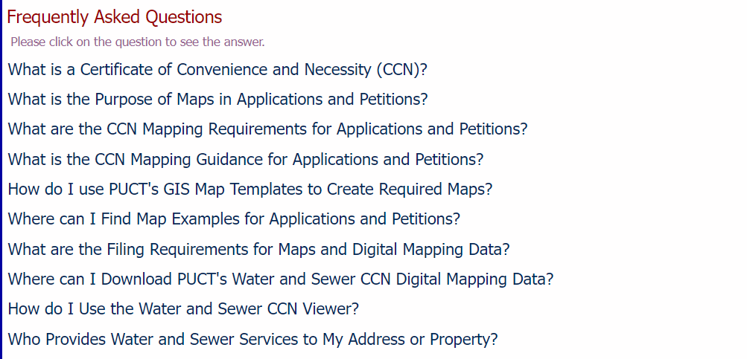
CCN Mapping Information Webpage
Notes:
Use the CCN Mapping Information webpage to prepare mapping information before filing an application or petition. It includes resources such as documents and answers to frequently asked questions for mapping professionals. These resources help avoid frequent mapping errors and reduce processing times of applications and petitions.

Slide 14
Mapping Requirements for Applications and Petitions: 16 TAC § 24.257
Resources
Mapping requirements
Mapping guidance
Map examples
Guidance documents
CCN digital mapping data
GIS map templates
CCN viewer
General location map identifying only the requested area, in reference to the nearest county boundary, city, or town.
Detailed map identifying only the requested area, in reference to verifiable man-made and natural landmarks, such as roads, rivers, and railroads.
Digital mapping data for the requested area must be provided as a single continuous polygon record that is georeferenced in a shapefile format.
Notes:
Standard mapping requirements include a general location map, a detailed map, and digital mapping data known as a shapefile. Staff will evaluate each of these items separately, to make sure each meets its respective requirements. Once an application or petition is filed staff can provide guidance during the review process to help meet these requirements.

Slide 15
Mapping Requirements for Streamlined Expedited Release (SER) and Expedited Release (ER): SER 16 TAC § 24.245(h) | ER 16 TAC § 24.245(f)
Resources
Mapping requirements
Mapping guidance
Map examples
Guidance documents
CCN digital mapping data
GIS map templates
CCN viewer
General location map identifying the tract of land, in reference to the nearest county boundary, city, or town.
Detailed map identifying the tract of land, in reference to verifiable man-made and natural landmarks, such as roads, rivers, and railroads.
Digital mapping data for the tract of land must be provided as a single continuous polygon record that is georeferenced in a shapefile format.
Notes:
Mapping requirements for streamlined expedited release and expedited release petitions are generally the same as those for standard CCN applications and petitions. The primary difference is that mapping information must identify the ‘tract or tracts of land’ that is submitted by the landowner, rather than identifying the ‘requested area.’ The maps submitted in these petitions will not be used for notice purposes to the public, they will be provided to the CCN holder impacted in the petition and Commission staff.

Slide 16
Resources
Mapping requirements
Mapping guidance
Map examples
Guidance documents
CCN digital mapping data
GIS map templates
CCN viewer
The maps filed must accurately identify the location of the requested area in reference to verifiable man-made and natural landmarks.
Maps must include a title, legend, north arrow and scale bar.
The requested area identified on the maps and the shapefile must identify the same boundary.
Notes:
Maps must identify the location of the requested area that is in reference to verifiable man-made and natural landmarks such as city limit boundaries, county boundaries, roads, railroads, and hydrology (such as: rivers, streams, and lakes). All maps must include a title stating the affected utility names and CCN numbers, a legend to symbolize the boundary of the requested area, a north arrow to position the viewer, and a scale bar to determine the distance and scale used on the map. The requested area displayed on the maps must match the boundary of the requested area in the shapefile.

Slide 17
Resources
Mapping requirements
Mapping guidance
Map examples
Guidance documents
CCN digital mapping data
GIS map templates
CCN viewer
For notice purposes:
Requested water and sewer areas must be shown on separate maps if the boundaries for each are different.
Map layouts should be either 8.5 x 11 inches or 11 x 17 inches.
Do not include surrounding CCN boundaries on maps.
Notes:
If requested areas for water and sewer CCN’s have different boundaries, each must be displayed on its own set of maps. Paper copies of these maps will be mailed for notice purposes, therefore, use map layouts that are 8.5 x 11 or 11 x 17 inches. To meet mapping requirements and for notice purposes, only identify the requested area on the maps and do not include surrounding CCN boundaries.

Slide 18
Resources
Mapping requirements
Mapping guidance
Map examples
Guidance documents
CCN digital mapping data
GIS map templates
CCN viewer
The outer boundary of the requested area must not be obstructed.
Verifiable man-made and natural landmarks, including their labels, must not be obstructed.
Notes:
For purposes of clarity, the outer boundary of the requested area must not be obstructed by other map labels or features. Also, the labels of verifiable man-made and natural landmarks must not be obstructed.

Slide 19
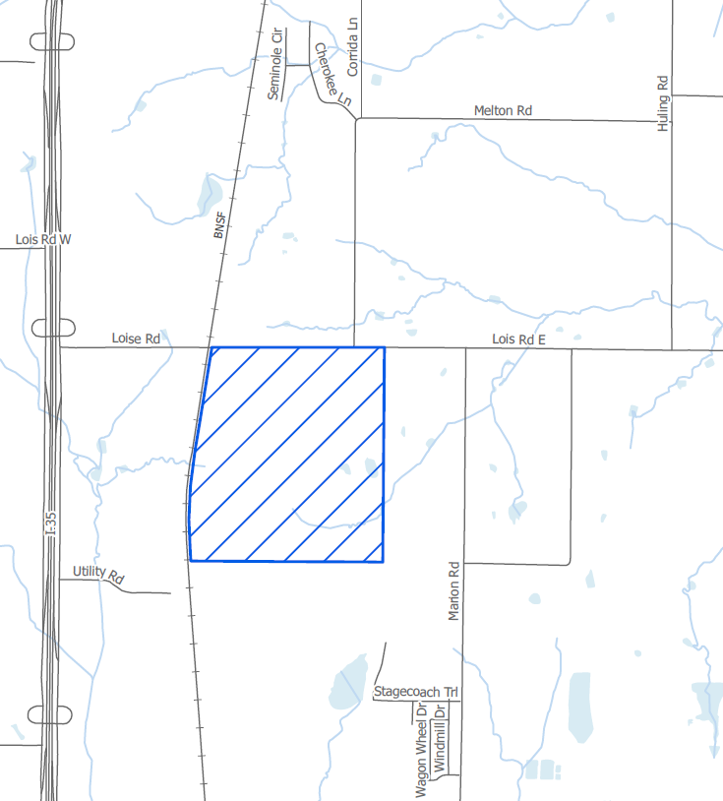
Requested Area Not Obstructed
Layer Order
Public Utility Commission of Texas
Notes:
In this example, the outer boundary of the requested area is clearly visible and takes precedence over other features in the layer order. The verifiable man-made and natural landmarks including their labels located to the north, east, south, and west of the requested area are clearly visible and do not obstruct the outer boundary of the requested area.

Slide 20
Map Examples for Applications and Petitions
Resources
Mapping requirements
Mapping guidance
Map examples
Guidance documents
CCN digital mapping data
GIS map templates
CCN viewer
CCN Amendment Application (Amend)
Sale, Transfer, or Merger (STM) Application (Straight)
STM & Amend Application
Streamlined Expedited Release (SER) Petition
Decertification Petition
13.248 Petition
13.255 Application
Exempt Utility Registration Application
Notes:
Map examples that meet mapping requirements for each application and petition type can be found on the website under ‘Where can I Find Map Examples for Applications and Petitions?’ Each bullet is a hyperlink that opens a PDF of a general location and detailed maps.

Slide 21
CCN Mapping Guidance for Applications and Petitions
Resources
Mapping requirements
Mapping guidance
Map examples
Guidance documents
CCN digital mapping data
GIS map templates
CCN viewer
Key to Map Titles and Legends for General Location and
Detailed Maps
Mapping Guidance for a Streamlined Expedited Release
Notes:
Under ‘What is the CCN Mapping Guidance for Applications and Petitions?’, there is a document named ‘Key to Map Titles and Legends for General Location and Detailed Maps’. This tool helps determine the map title and map legend that supports the intent of the application or petition.

Slide 22
Downloadable Water and Sewer CCN Digital Mapping Data
Resources
Mapping requirements
Mapping guidance
Map examples
Guidance documents
CCN digital mapping data
GIS map templates
CCN viewer
Notes:
Applicants should verify the boundary of the requested area aligns accurately with existing CCN boundaries, meaning the shapefile of the requested area does not have overlaps or gaps with existing CCNs. To ensure this, applicants should always download the latest water and sewer CCN data.
There are two zip files available for download: one for water CCNs and another for sewer CCNs. This CCN data is updated quarterly. Please note the shapefiles are provided in a Texas Statewide Mapping System projection that can be used with GIS software. If using AutoCAD software to create the requested area, first determine the surrounding CCNs impacting the requested area, and then contact the Mapping Section to request the necessary CCN shapefiles in the appropriate State Plane Coordinate System.

Slide 23
Downloadable GIS Map Templates
Resources
Mapping requirements
Mapping guidance
Map examples
Guidance documents
CCN digital mapping data
GIS map templates
CCN viewer
Editable templates are available to help mapping professionals create required maps. Each version has a shapefile folder loaded with cities, counties, roads, railroads and hydrology data.
ArcMap (10.8.2)
ArcMap (10.0)
ArcGIS Pro
Notes:
Three sets of GIS map templates are available for download: the current version of ArcMap, an older version of ArcMap, and ArcGIS Pro. These new templates are editable and will streamline the process to create customized maps that meet mapping requirements. Specific steps to work with these templates are on the webpage.

Slide 24
Resources
Mapping requirements
Mapping guidance
Map examples
Guidance documents
CCN digital mapping data
GIS map templates
CCN viewer
Notes:
A link to the Water and Sewer CCN Viewer can be found on the CCN Mapping Information webpage. The viewer helps determine potential water and sewer utility providers. Use the CCN Number or an address to locate, view, and print a map of an existing water and sewer CCN boundary.

Slide 25
Create
Map elements
General location map
Detailed map
Digital mapping data (shapefile)
Notes:
Using this checklist, you can create the mapping information required to file with an application or petition. Mapping information consists of a general location map, a detailed map and a shapefile.

Slide 26
Create
Map elements
General location map
Detailed map
Digital mapping data (shapefile)
Map elements must include:
Title
Legend
North arrow
Scale bar
Notes:
Each map created must include, a title stating the affected utility names and CCN numbers, a legend to identify and symbolize the boundary of the requested area or tract of land, a north arrow to show the direction of north on the map and a scale bar to determine the distance and scale used on the map.

Slide 27
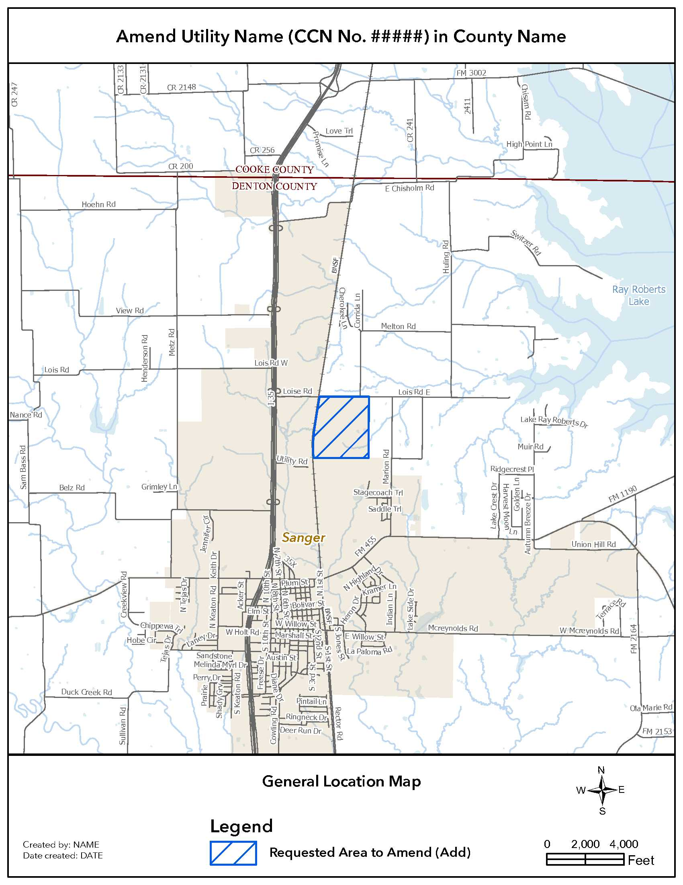
Create
Map elements
General location map
Detailed map
Digital mapping data (shapefile)
General Location Map
Small Scale = Zoomed Out
Notes:
This is an example of a general location map that meets mapping requirements. The general location map must show the location of the requested area zoomed out in reference to the nearest verifiable man-made and natural landmarks such as city limit and county line boundaries.

Slide 28
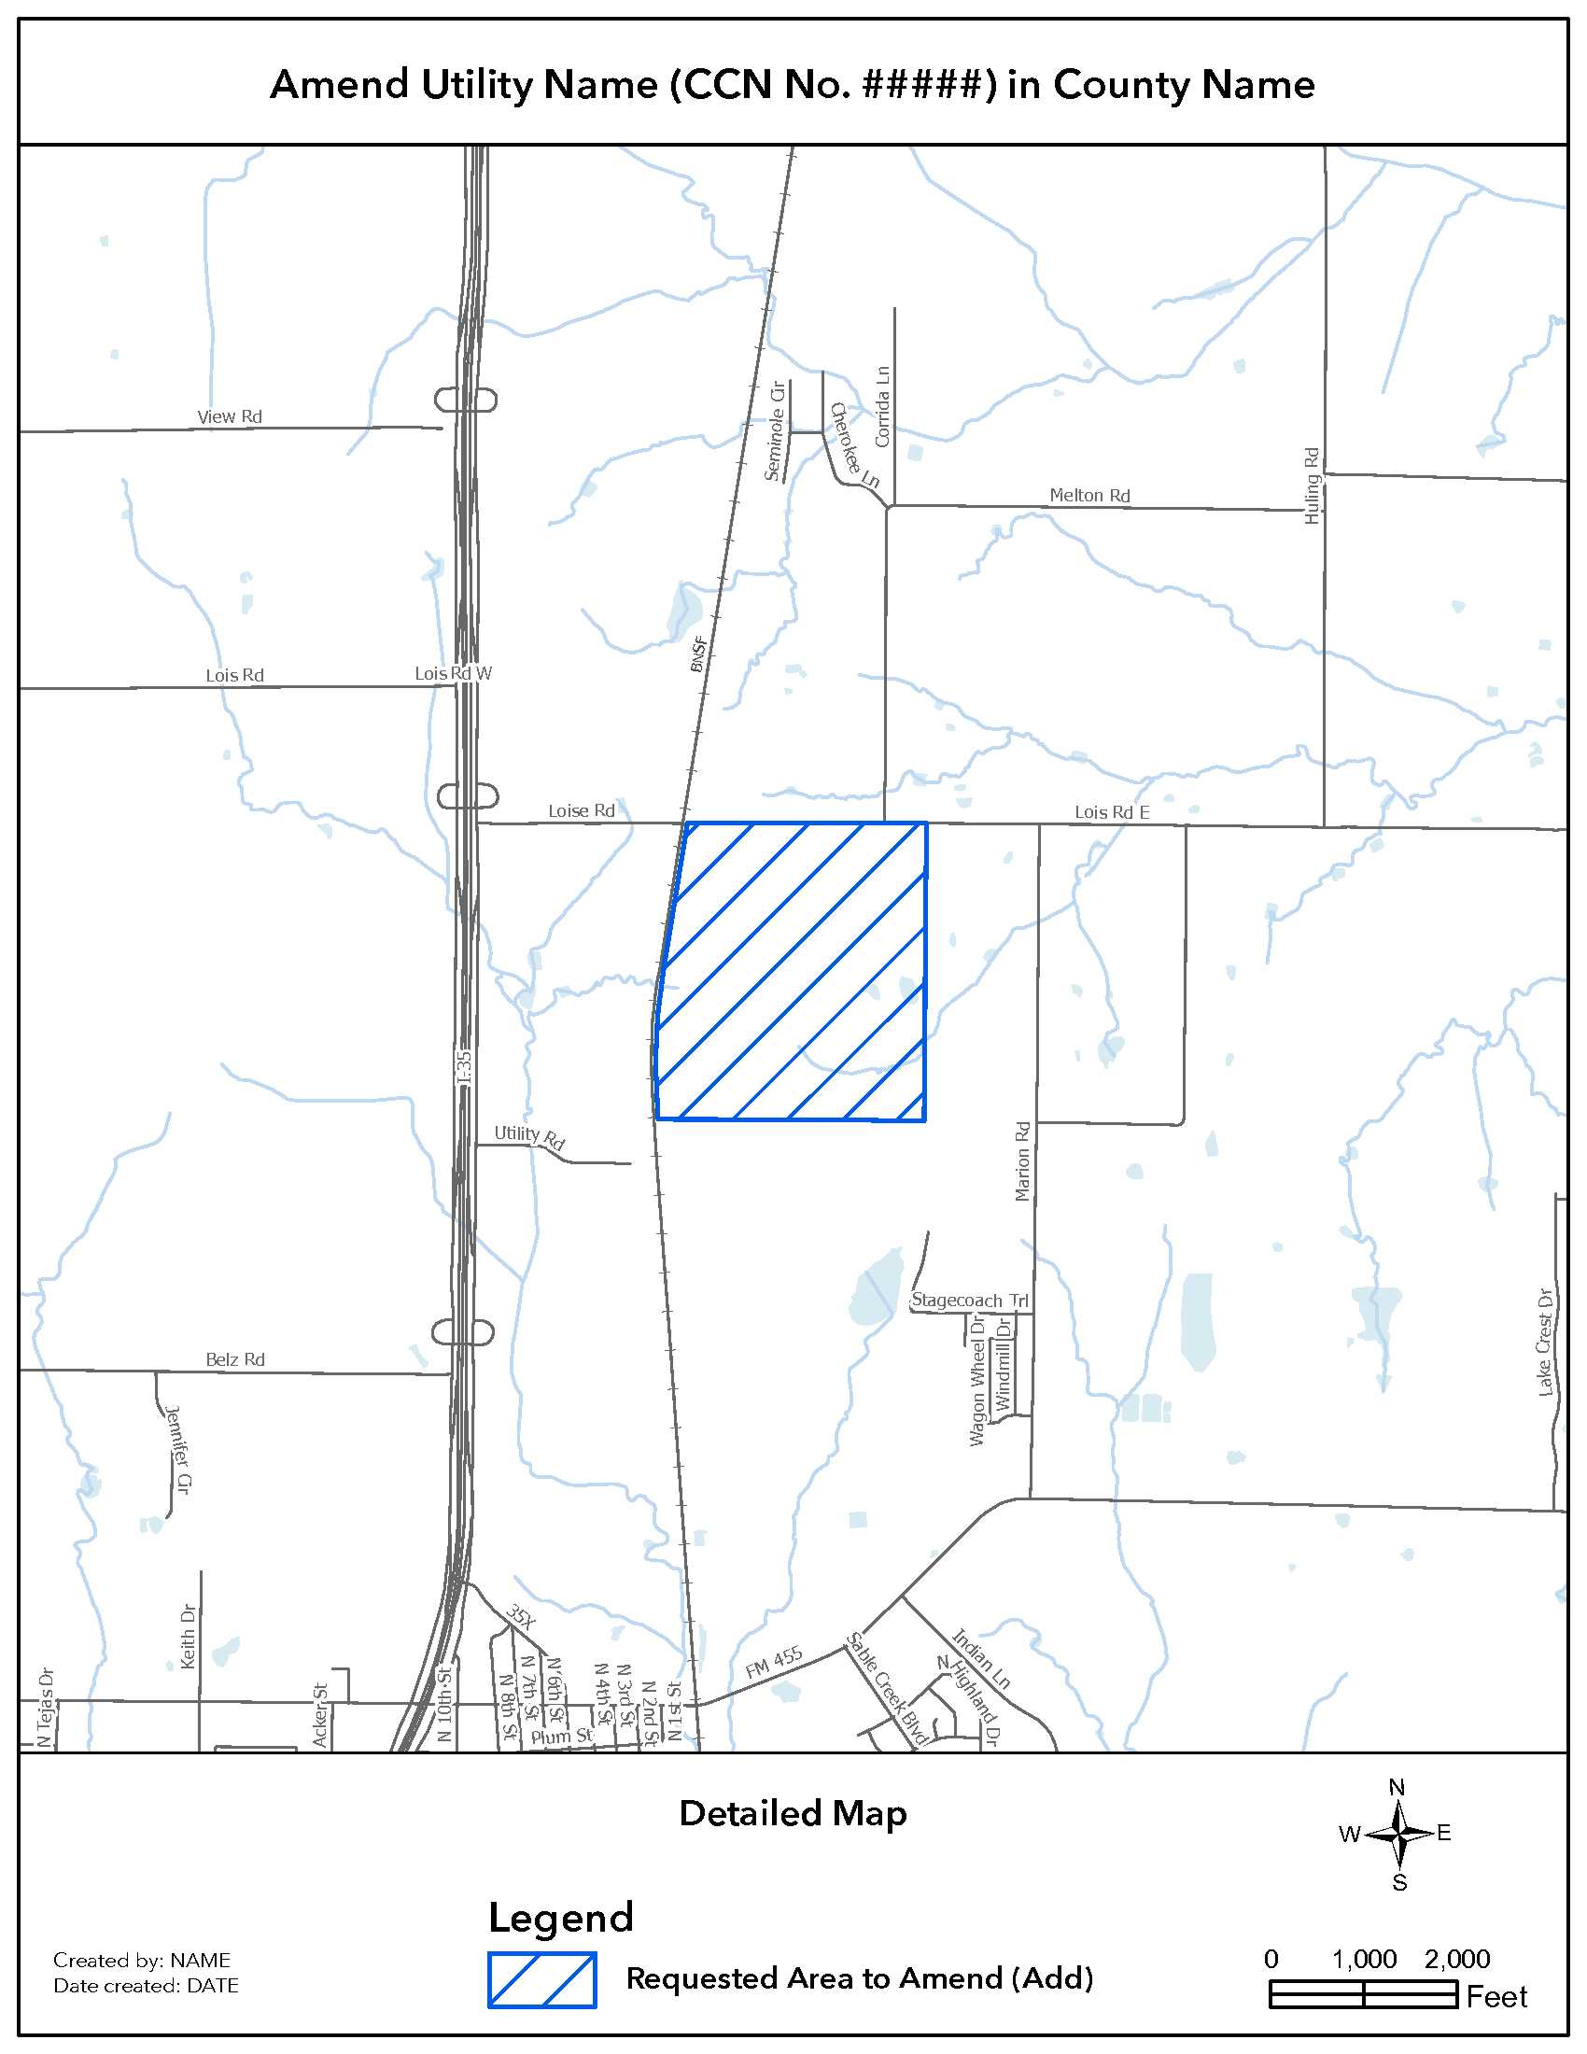
Create
Map elements
General location map
Detailed map
Digital mapping data (shapefile)
Detailed Map
Large Scale = Zoomed In
Notes:
This is an example of a detailed map that meets mapping requirements. The detailed map shows the location of the requested area zoomed in and in reference to the nearest north, east, south, and west verifiable man-made and natural landmarks such as roads, rivers, and railroads.
If the requested water and sewer boundaries differ, they must be shown on separate general location and detailed maps.

Slide 29
Create
Map elements
General location map
Detailed map
Digital mapping data (shapefile)
Boundaries for the requested area must share coincident boundaries with existing CCN’s and city limits, where appropriate.
All shapefiles must be georeferenced in either NAD 83 Texas State Plane Coordinate System (US Feet) or NAD 83 Texas Statewide Mapping System (meters).
Shapefiles acreage for the requested area must match what is stated in the application or petition.
Notes:
When creating the shapefile for the requested area, in most cases the boundary must accurately align with existing CCN boundaries.
Also, the shapefile for the requested area must be properly georeferenced.
Ensure the acreage calculated in the shapefile matches what is stated in the application or petition.

Slide 30
E-File
E-filing mapping information:
Include the required file extensions for a usable shapefile
.dbf, .prj, .shp, .shx
Include each PDF map at the original scale and size, that is in color or gray scale ready.
Include cover letter for revised maps and shapefiles
Provide a statement indicating reason for revised mapping information; and
List the mapping information that is included in the filing.
Notes:
Submit the required maps and corresponding shapefile through the PUCT Interchange System. A useable shapefile must include these four file extensions.
Maps must be submitted in a PDF format, in the original scale, and either in color or gray-scale ready. Scanned copies do not meet mapping requirements and will not be accepted.
If staff provides mapping guidance to help resolve any issues, the revised mapping information should include a cover letter stating what the filing includes. If mapping revisions are necessary, refile both the general location and detailed maps together.

Slide 31
Support
Guidance will be provided throughout the application or petition process.
Staff may only provide general guidance before an application or petition is filed.
Specific guidance is based on a review of the information contained in the application or petition.
Notes:
Mapping professionals should work directly with Mapping Section staff throughout the application or petition process to ensure the mapping requirements are met. Staff may only provide general guidance before an application or petition is formally filed through the PUCT Interchange System.
Therefore, specific guidance based on a complete review of the application or petition, maps, and shapefiles may differ from the general guidance provided before the application or petition is formally filed.

Slide 32
Checklist Summary
Need to Know
Resources
Create
E-File
Support
Notes:
In summary, the team should work together to understand the intent of the application or petition. Knowing the intent is key to create mapping information that supports the application or petition filed.
Mapping professionals should familiarize themselves with the PUCT’s mapping requirements, guidance, and resources before filing an application or petition.
Collaboration between the mapping professional and the Mapping Section staff during the application or petition process helps the applicant effectively and efficiently meet the mapping requirements.

Slide 33
The End
Contact Mapping Section staff
by email at: water@puc.texas.gov
Notes:
This concludes our presentation. For questions, please contact the Mapping Section staff. Thank you and happy mapping.

